Slide 1
PEMOGRAMAN
WEB ENTERPRISE
05
Fungsi String
FASILKOM
Hariesa B.P, ST, MM
Sistem Informasi

Slide 2
Fungsi String

Slide 3
Definisi
Fungsi String : Merupakan fungsi yang digunakan untuk melakukan manipulasi string dalam berbagai cara.

Slide 4
Syntax
Syntax fungsi String diantaranya:
explode — Split a string by string
ltrim — Strip whitespace (or other characters) from the beginning of a string
md5 — Calculate the md5 hash of a string
str_replace — Replace all occurrences of the search string with the replacement string
str_split — Convert a string to an array
strlen — Get string length
strrev — Reverse a string
strtolower — Make a string lowercase
strtoupper — Make a string uppercase
substr_replace — Replace text within a portion of a string
substr — Return part of a string
trim — Strip whitespace (or other characters) from the beginning and end of a string
ucfirst — Make a string's first character uppercase
ucwords — Uppercase the first character of each word in a string

Slide 5
Explode
explode ( string $delimiter , string $string [, int $limit ] )
<?php
$pizza = "piece1 piece2 piece3 piece4 piece5"; $pieces = explode(" ", $pizza); echo $pieces[0]. “<br />”; // piece1 echo $pieces[1]; // piece2
?>

Slide 6
Syntax (2)
strlen ( string $string )
<?php
$str = ' ab cd '; echo strlen($str); // 7 ?>

Slide 7
Syntax (3)
strtolower ( string $str )
<?php $str = "Mary Had A Little Lamb and She LOVED It So"; $str = strtolower($str); echo $str; ?>

Slide 8
Syntax (4)
strtoupper ( string $string )
<?php $str = "Mary Had A Little Lamb and She LOVED It So"; $str = strtoupper($str); echo $str; ?>

Slide 9
Syntax (5)
substr ( string $string , int $start [, int $length ] )
<?php $rest = substr("abcdef", 0, -1);
Echo $rest.”<br />”;
$rest = substr("abcdef", 0, 1);
Echo $rest.”<br />”; $rest = substr("abcdef", 2, -1);
Echo $rest.”<br />”; $rest = substr("abcdef", 2, 1); ?>
Echo $rest.”<br />”;

Slide 10
Syntax (6)
strrev ( string $string )
<?php echo strrev("Hello world!"); ?>

Slide 11
Syntax (7)
ucfirst ( string $str )
<?php $foo = 'hello world!'; $foo = ucfirst($foo); echo $foo.”<br />”; $bar = 'HELLO WORLD!'; $bar = ucfirst($bar); $bar = ucfirst(strtolower($bar));
Echo $bar.”<br />”; ?>

Slide 12
Syntax (8)
ucwords ( string $str )
<?php $foo = 'hello world!'; $foo = ucwords($foo); // Hello World! echo $foo;
?>

Slide 13
Syntax (9)
trim ( string $str [, string $charlist ] )
<?php
$hello = “ Hello World ";
echo trim($hello);
?>

Slide 14
Syntac 10
date ( string $format [, int $timestamp = time() ] )
<?php // prints something like: Sunday 5th of May 2013 11:17:20 AM echo date('l jS \of F Y h:i:s A'); ?>

Slide 15
Practice (update frmhasil.php)

Slide 16
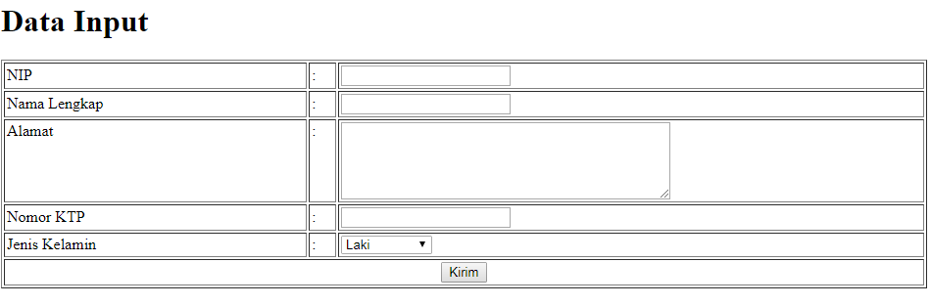

UI

Slide 17
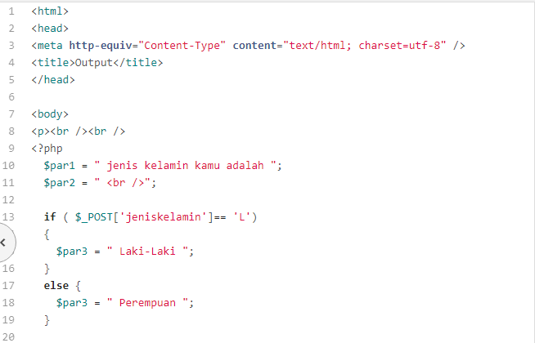

Slide 18
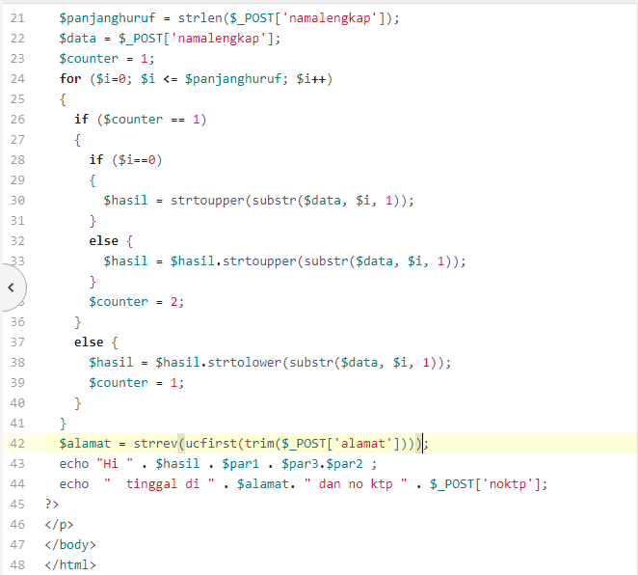

Slide 19
Tugas dikumpulkan 26/10/2018 Maksimal jam 13.00

Slide 20
Aturan Tugas
Nama file : - NIM_tugas1_input.php
- NIM_tugas1_output.php
- NIM_tugas2_input.php
- NIM_tugas2_output.php
Paramater = semua parameter diawali dengan NIM

Slide 21
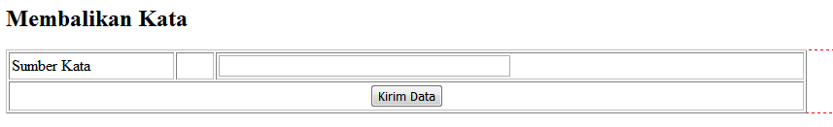
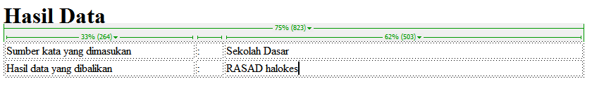
Tugas 1

Slide 22
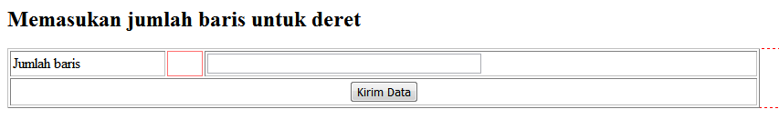
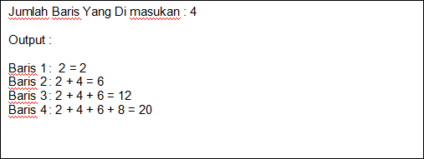
Tugas 2

